Slide 2
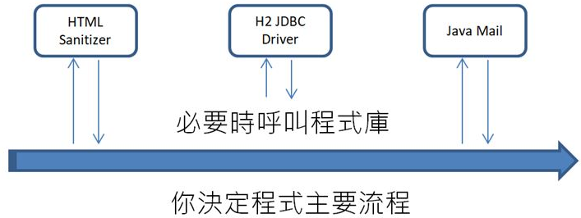
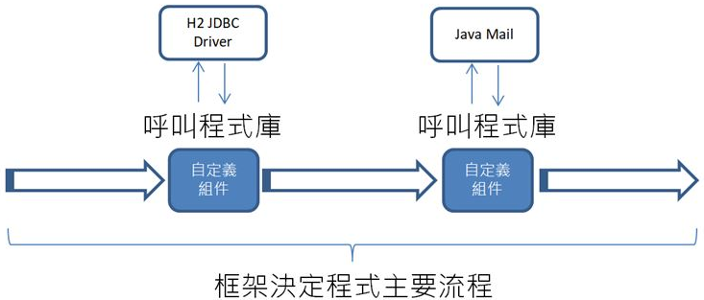
Dependency injection
Inversion of control

Slide 3
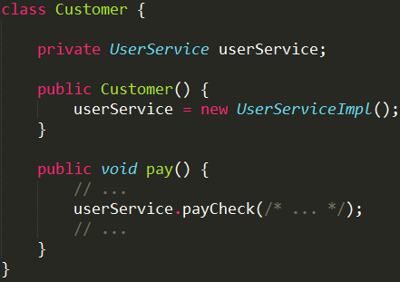
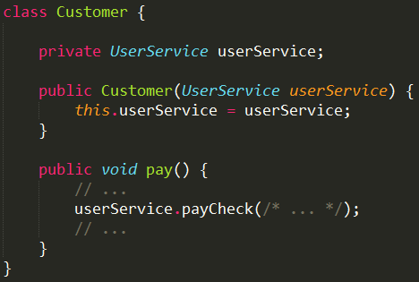
Dependency injection
Inversion of control
Dependency injection (Dependency Inversion Principle, DIP (SOLID))

